Slide 1
Spark STREAMING

Slide 2
What is Spark Streaming?
Framework for large scale stream processing
Scales to 100s of nodes
Can achieve second scale latencies
Integrates with Spark’s batch and interactive processing
Provides a simple batch-like API for implementing complex algorithm
Can absorb live data streams from Kafka, Flume, ZeroMQ, etc.

Slide 3
Motivation
Many important applications must process large streams of live data and provide results in near-real-time
Social network trends
Website statistics
Intrusion detection systems
etc.
Require large clusters to handle workloads
Require latencies of few seconds

Slide 4
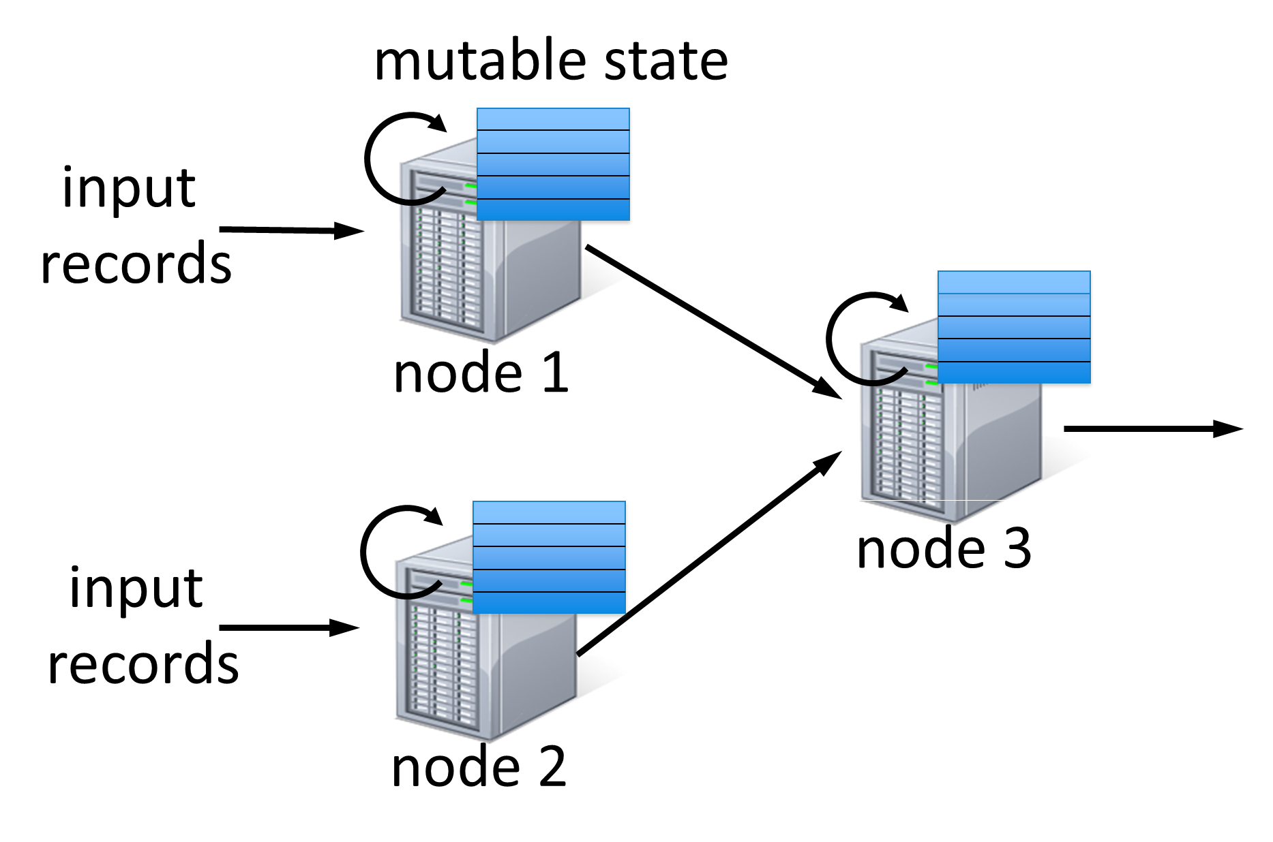
Stateful Stream Processing
Traditional streaming systems have a event-driven record-at-a-time processing model
Each node has mutable state
For each record, update state & send new records
State is lost if node dies!
Making stateful stream processing be fault-tolerant is challenging

Slide 5
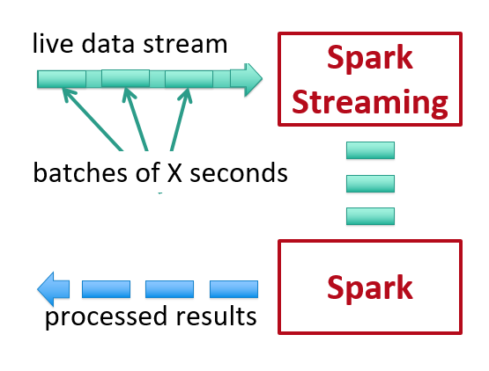
Discretized Stream Processing
Run a streaming computation as a series of very small, deterministic batch jobs
Chop up the live stream into batches of X seconds
Spark treats each batch of data as RDDs and processes them using RDD operations
Finally, the processed results of the RDD operations are returned in batches

Slide 6
Structured Streaming
Structured Streaming is a scalable and fault-tolerant stream processing engine built on the Spark SQL engine.
We can express our streaming computation the same way we would express a batch computation on static data.
The Spark SQL engine will take care of running it incrementally and continuously and updating the final result as streaming data continues to arrive.
Finally, the system ensures end-to-end exactly-once fault-tolerance guarantees through check-pointing and Write Ahead Logs.
In short, Structured Streaming provides fast, scalable, fault-tolerant, end-to-end exactly-once stream processing without the user having to reason about streaming.

Slide 7
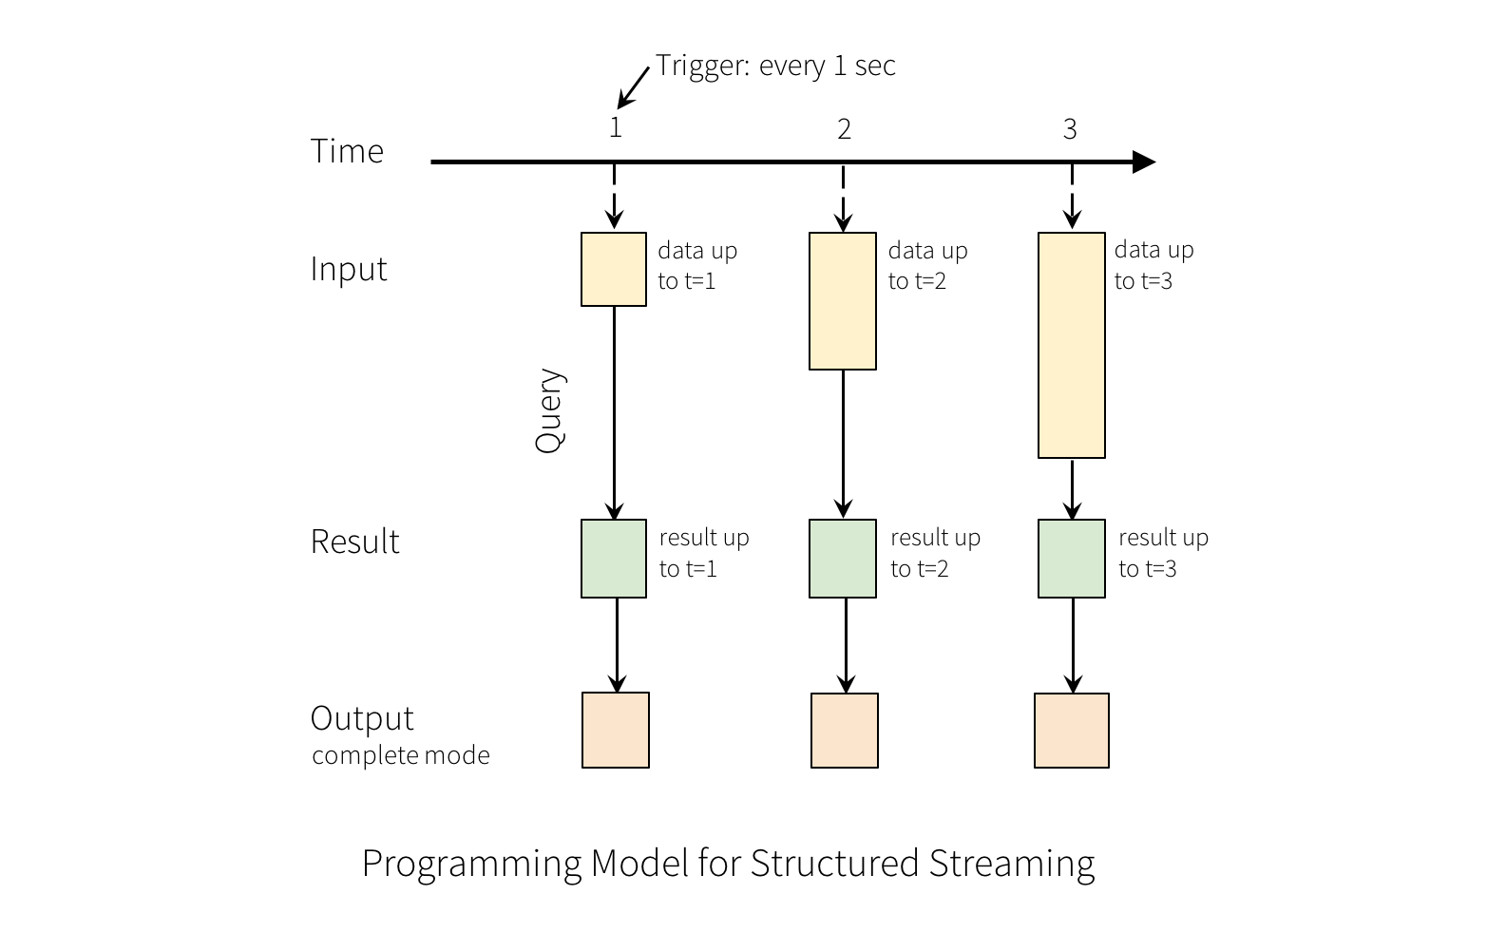
Structured Streaming
A query on the input will generate the “Result Table”.
Every trigger interval (say, every 1 second), new rows get appended to the Input Table, which eventually updates the Result Table.
Whenever the result table gets updated, we would want to write the changed result rows to an external sink.

Slide 8
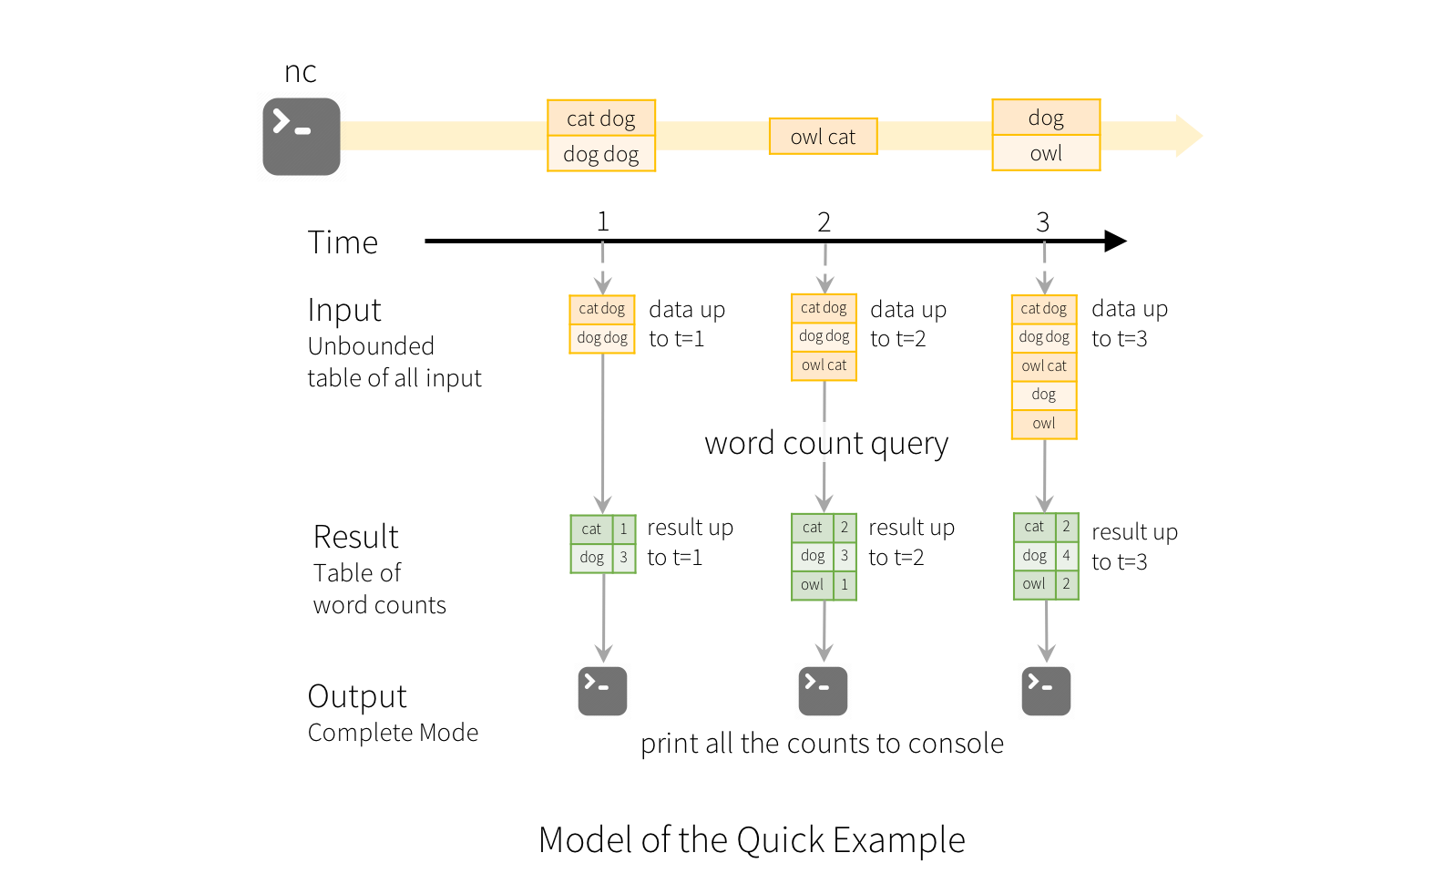
Structured Streaming
Spark will continuously check for new data from the socket connection.
If there is new data, Spark will run an “incremental” query that combines the previous running counts with the new data to compute updated counts, as shown below.

Slide 9
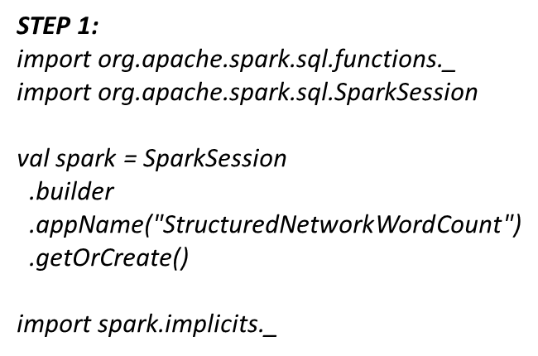
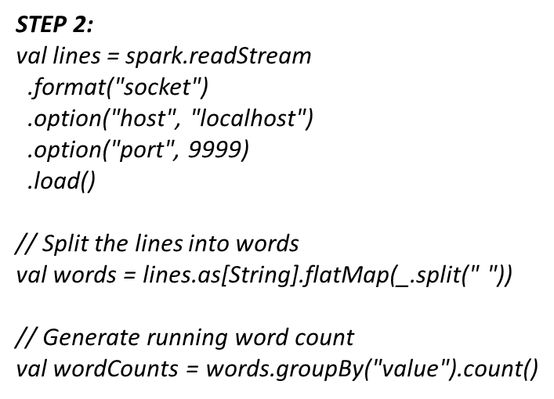
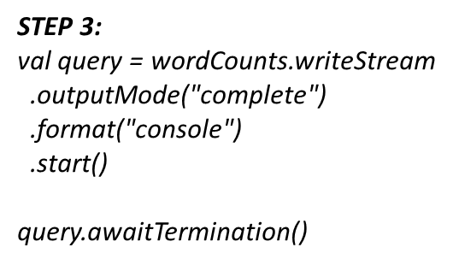
Structured Streaming

Slide 10
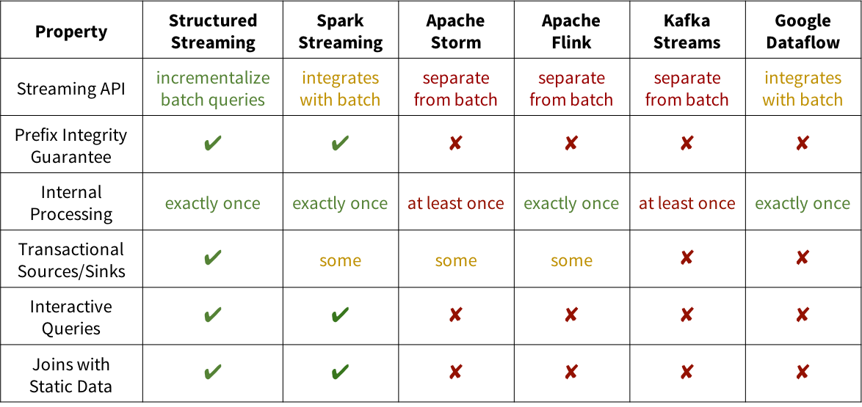
Comparison

Slide 11
Structured Streaming
Recovering from Failures with Checkpointing
In case of a failure or intentional shutdown, we can recover the previous progress and state of a previous query, and continue where it left off.
This is done using checkpointing and write ahead logs.
We can configure a query with a checkpoint location, and the query will save all the progress information.
This checkpoint location has to be a path in an HDFS compatible file system, and can be set as an option in the DataStreamWriter when starting a query.
aggDF.writeStream.outputMode("complete").option("checkpointLocation", "path/to/HDFS/dir")
.format("memory")
.start()

